Slide 1
PREDICTING CUSTOMER CHURN USING LOGISTIC REGRESSION
Name: Raksha U
Department: MCA (BCU)
Semester: Third
USN: P18BR23S126017

Slide 2
Outline
Title Name
Outline
Abstract
Problem Statement
Proposed Solution
Short Video
Implementation
Output Screenshots
References

Slide 3
Abstract:
Customer churn prediction is vital for improving customer retention strategies.
This project employs logistic regression to predict customer churn using a real-world dataset.
Steps include data preprocessing, model training, and evaluation, followed by actionable insights for business decision-making.

Slide 4
Problem Statement
Customer churn is a critical issue for businesses, directly impacting revenue and growth.
Identifying patterns in customer behavior that indicate a higher likelihood of churn is essential.
The dataset includes customer information, and the goal is to predict whether a customer will churn (Yes) or not (No).

Slide 5
Proposed Solution
Loading the Dataset: Import and explore the customer churn dataset. Data Pre-processing:
Handle missing values.
Encode categorical variables.
Address any class imbalance.
Feature Splitting: Divide the data into training and testing subsets.
Model Training: Use logistic regression to train the model.
Evaluation: Assess model performance using:
Accuracy
Classification Report
Confusion Matrix

Slide 6
Short Video
https://drive.google.com/file/d/1BIV7AoA1VfCcNAzE632XUe6Uhd4_VYlu/view?usp=sharing

Slide 7
Implementation
https://github.com/Raksh9a171/Final

Slide 8
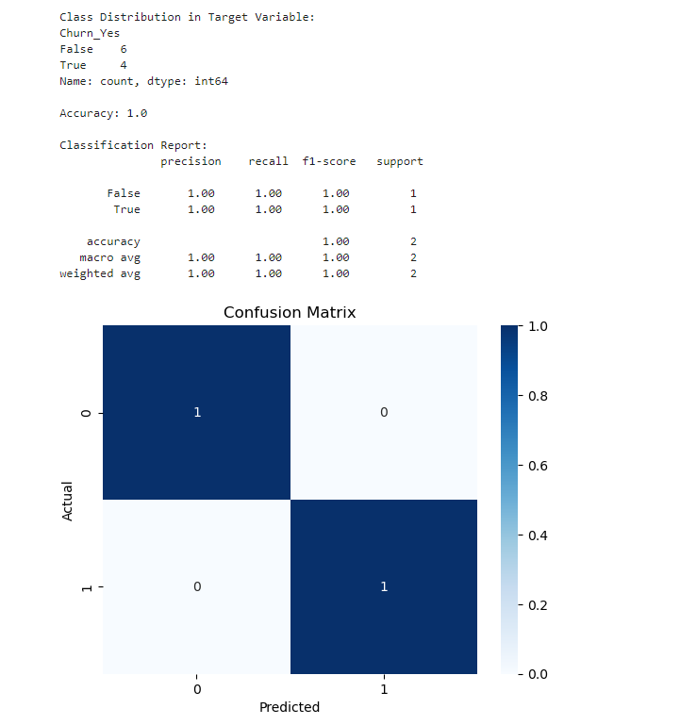
Output

